Slide 1
Sentiment Analysis on Hotel Reviews Group 7 Ajith Busipally Pavansai Pottimuthi Siva Teja Segu Sreehari Revuri

Slide 2
Introduction
Sentiment analysis is a technique used in Natural Language Processing that extracts emotions from raw texts. Most ecommerce sites, including Amazon, Flipkart, and Google, have a variety of applications built on this technology.
Consider the Google Translate app. It is particularly good at comprehending, analyzing, and translating data.

Slide 3
Problem Statement
The project's goal is to perform sentiment analysis on a dataset of hotel reviews.
Given a customer review, we must predict whether the review is favorable or unfavorable, or positive or negative.
We want to predict whether a textual review corresponds to a positive (satisfied) or negative review (the customer is not satisfied).

Slide 4
Why is it important?
As it enables organizations to analyze massive volumes of unstructured data effectively and economically, sentiment analysis
is proven to be a useful tool.
It gives facts and quantifiable data for upcoming decision-making, and when done well, it delivers value to a business.
Sentiment research should be used by businesses that want to improve their goods and services, increase sales, and outwit their rivals.

Slide 5
Literature Review
Humera Shaziya et al. in this paper classified movie reviews for sentiment analysis using WEKA Tool. They enhanced the earlier work done in sentiment categorization which analyzes opinions which express either positive or negative sentiment
Nandal. in this paper classified amazon product reviews for sentiment analysis using SVM(Support Vector Machine) Tool. The study examined how words can shift in meaning depending on the context in which they're used, and how this impacts the overall evaluation of a product and its specific features. The findings of the analysis were impressive.

Slide 6
Proposal Model
The research began with an examination of many research and review articles on sentiment analysis, and each publication's summary was prepared by reading and comprehending the document.
Examine popular classification techniques such as Nave Bayes, Random Forest, k-nearest neighbor, Decision Tree Induction, and Support Vector Machine.

Slide 7
Milestones
Milestone 1: Data Preparation and data exploration
Pandas describe method will give some statistical parameters of the dataset like count, mean and standard deviation.
To get a quick overview of the dataset we will use the dataframe.info() function.

Slide 8
Milestones
Milestone 2: Data Cleaning
Cleaning and preprocessing of data
Using the gensim module, use the DOC2VEC function to convert text to vectors
By using SentimentIntensityAnalyzer we find the polarity scores and plot word cloud

Slide 9
Milestones
Milestone 3: Classifier
We will use Random forest as a learning method (it can be used for both classification and regression tasks)
It makes group of decision trees, usually trained with the “bagging” method

Slide 10
Milestones
Milestone 4: Performance & Evaluation
We will use ROC(Receiver Operating Characteristics) curve and AUC ( Area Under the Curve)
Through this we can evaluate false positive rate & true positive rate for each feasible cut-off value

Slide 11
Background
What is sentiment analysis?
Sentiment analysis is a process of identifying and extracting opinions and emotions expressed in text data using natural language processing techniques
Sentiment analysis encompasses various techniques used to analyze the emotions, opinions, and attitudes expressed in text
The analysis ranges from simple polarity classification to more advanced methods such as aspect-based sentiment analysis and emotion detection

Slide 12
Contd..
What is hotel review?
A hotel review is a brief statement expressing a person's evaluation of their experience staying at a particular hotel
Hotel review evaluations typically contain feedback on the overall experience by the guests

Slide 13
Dataset
The following attributes are considered as our dataset:
Hotel-Address ReviewTotalPositiveWordCounts
Review-Date Average-Score
Hotel-Name Reviewer-Nationality
Negative-Review ReviewTotalNegativeWordCounts
Positive-Review ReviewTotalPositiveWordCounts
Reviewer-Score TotalNumberofReviewsReviewerHasGiven
TotalNumberof-Reviews Tags
Dayssincereview AdditionalNumberof-Scoring
Latitude Longitude

Slide 14
Key Concepts
NLP(Natural Language Processing):
It has ability to not just read but understands and interpret human language.
NLP tools process data in real time, 24/7, and apply the same criteria to all your data, so you can ensure the results you receive are accurate – and not riddled with inconsistencies.
Notes:
Often used by businesses to automatically detect brand sentiment on social media. Analyzing these interactions can help brands detect urgent customer issues that they need to respond to right away, or monitor overall customer satisfaction.
Human language is complex, ambiguous, disorganized, and diverse. There are more than 6,500 languages in the world, all of them with their own syntactic and semantic rules. Even humans struggle to make sense of language.

Slide 15
Bag of Words ( BOW)
Raw text is initially preprocessed and the processing and cleaning techniques
Remove all unnecessary special characters, if there are words of other accent like polish, German, Spanish etc. Remove or replace them or add the right unicode to make them readable for machine.

Slide 16
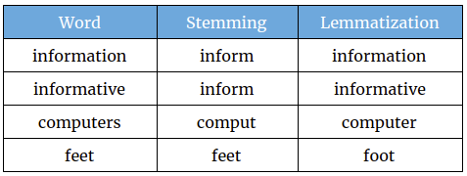
Lemmatization
Methods used by search engines and chatbots to analyze the meaning behind a word.
Stemming uses the stem of the word
Lemmatization uses the context in which the word is being used
Notes:
Lemmatization is one of the technique used to clean data.
Ppt
We are have two techniques to clean data, stemming and lemmatization
Stemming:
For example, consider word “information” , where the stemming convert these type of words to base word as “inform”.
Lemmatization used vocabulary and morphological analysis of words, normally aiming to remove inflectional endings only and to return the base or dictionary form of a word, which is known as the lemma(base)
Example:
For example, consider “ computers” from the table displayed. Lemmatization has converted it to dictionary form of word computer

Slide 17
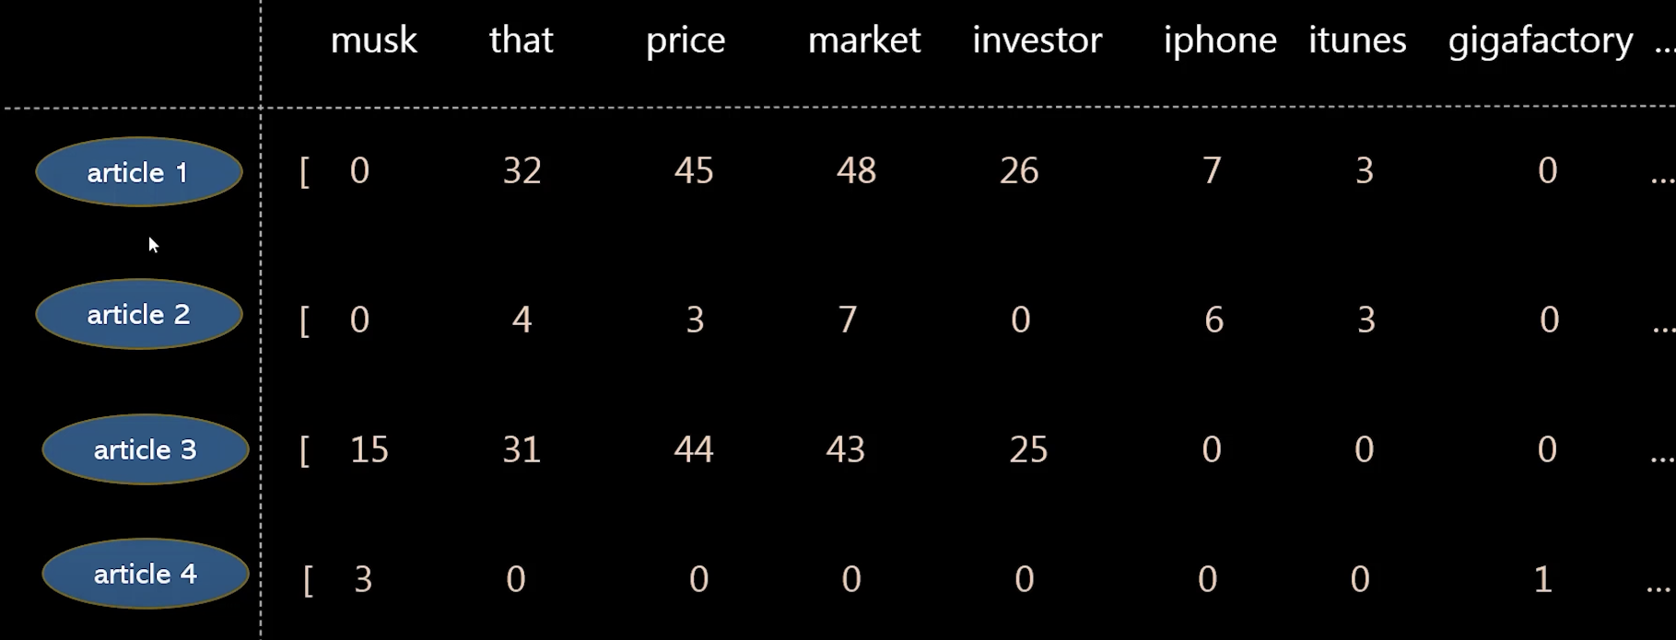
TF-IDF (Term Frequency and Inverse Dense Frequency)
Inverse document frequency looks at how common (or uncommon) a word is amongst the document
IDF =Log [(# Number of documents) / (Number of documents containing the word)]
Term frequency works by looking at the frequency of a particular term you are concerned with relative to the document
TF = (Number of repetitions of word in a document) / (# of words in document)
TF – IDF = TF(t, d) * IDF(t)
Notes:
So, using TF and IDF machine makes sense of important words in a document and important words throughout all documents.
IDF(t) = 4/1 = 4
TF = consider airtcle 1, where assume that it has total words 1000.
TF(t,d) = iphone(7)/1000 is TF value

Slide 18

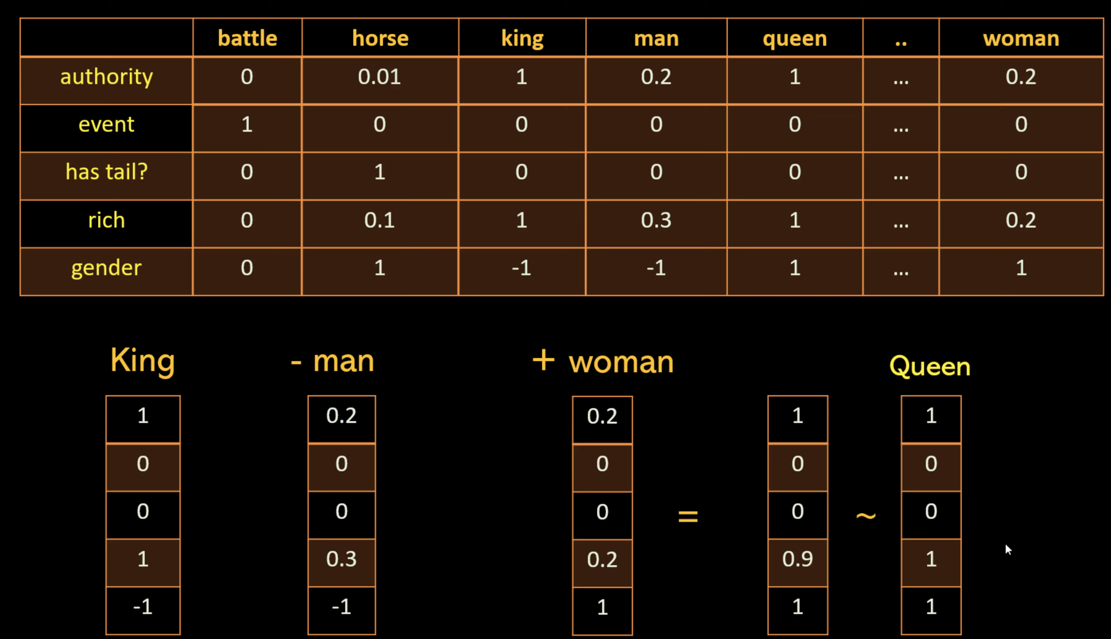
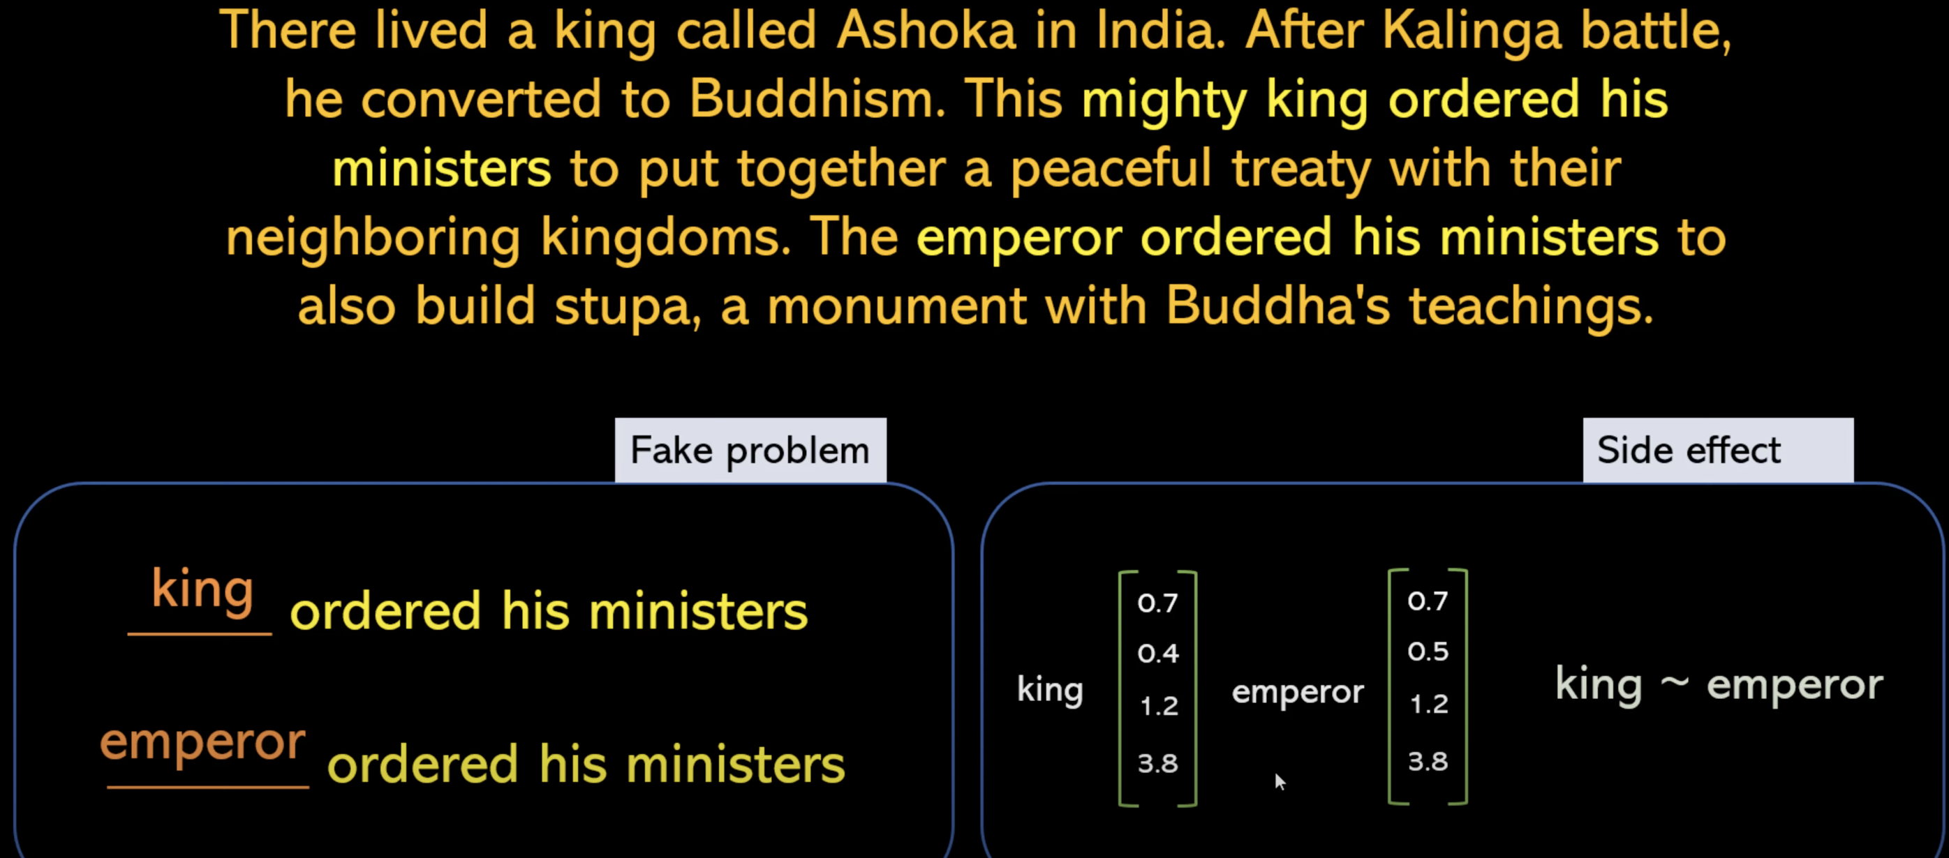
Word2vec
Word2Vec is a natural language processing technique used for generating word embeddings, which are numerical vector representations of words.
Notes:
Neural Network training is used to train word2vec.

Slide 19
Random Forest
It is flexible, easy to use machine learning algorithm that produces, even without hyper-parameter tuning.
The "forest" it builds, is an ensemble of decision trees, usually trained with the “bagging” method

Slide 20






Infrastructure

Slide 21
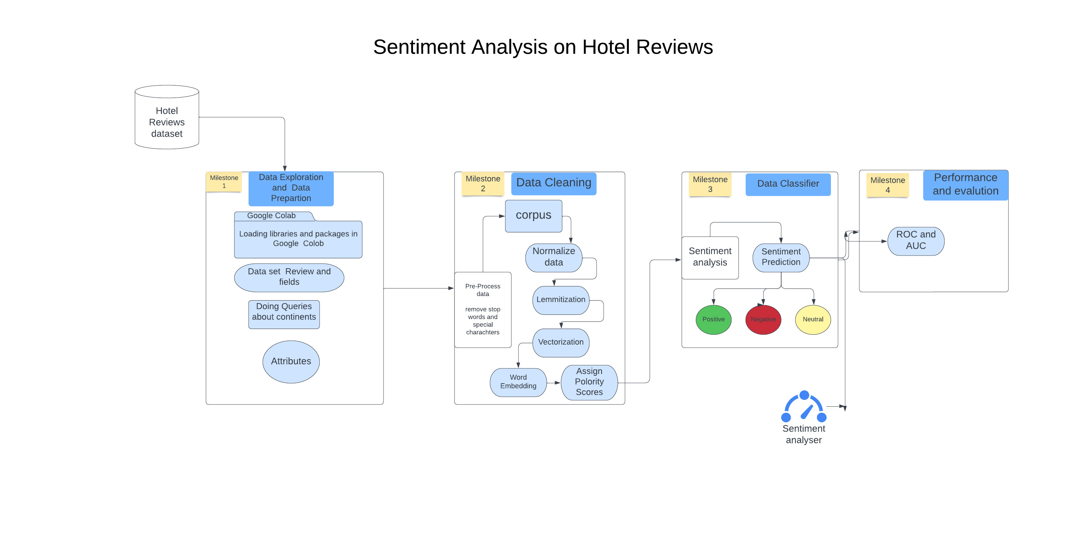
System Architecture

Slide 22
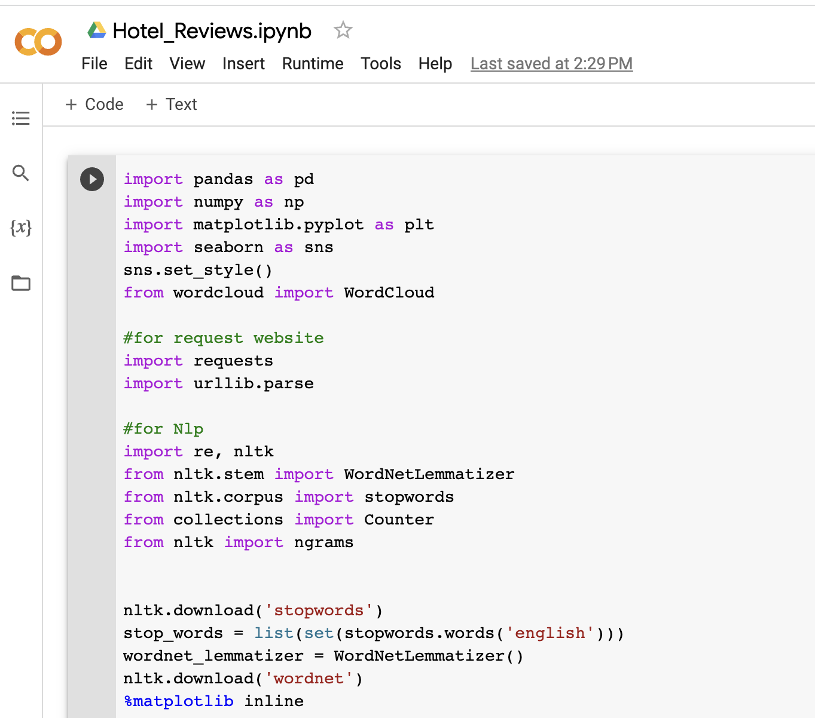




Workflow
Milestone 1: Data Exploration & Preparation

Slide 23
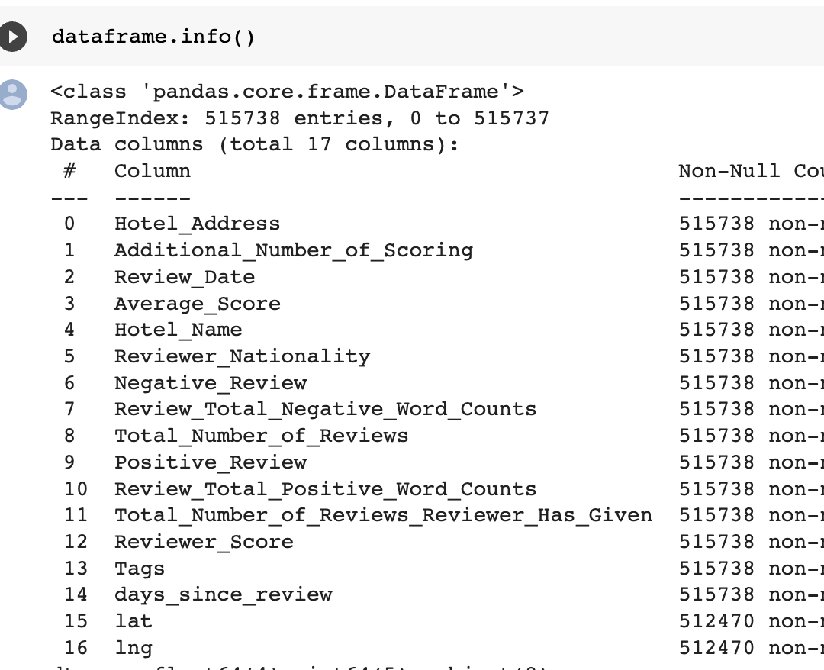
Workflow
Data Description
The data has been taken from booking.com, kaggle site and contains the following fields:

Slide 24
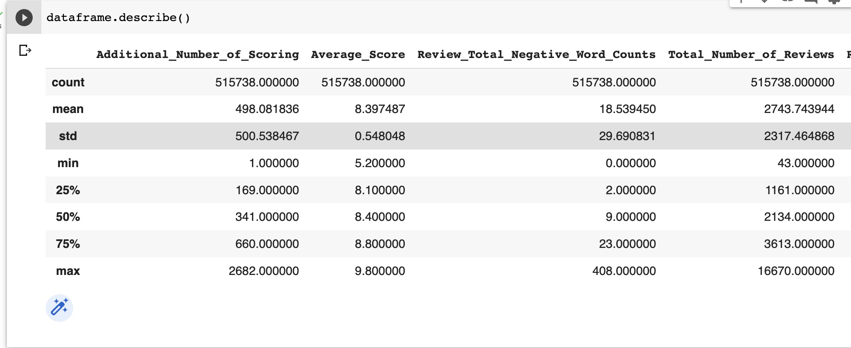
Contd..
Queries

Slide 25
DATA CLEANING
Steps followed for data cleaning:
Remove no negatives and no positives from data
Clean textual data using
Parts of speech
Word lemmatization

Slide 26
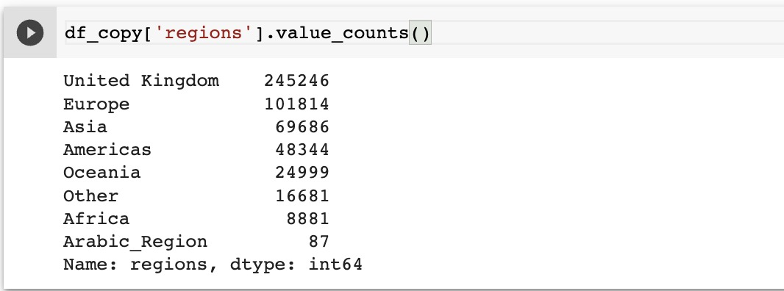
CONTD..
Added a new column ”Region” to our data set by using countryContinent.csv file to find from which country/state most of the people visited the hotel.

Slide 27
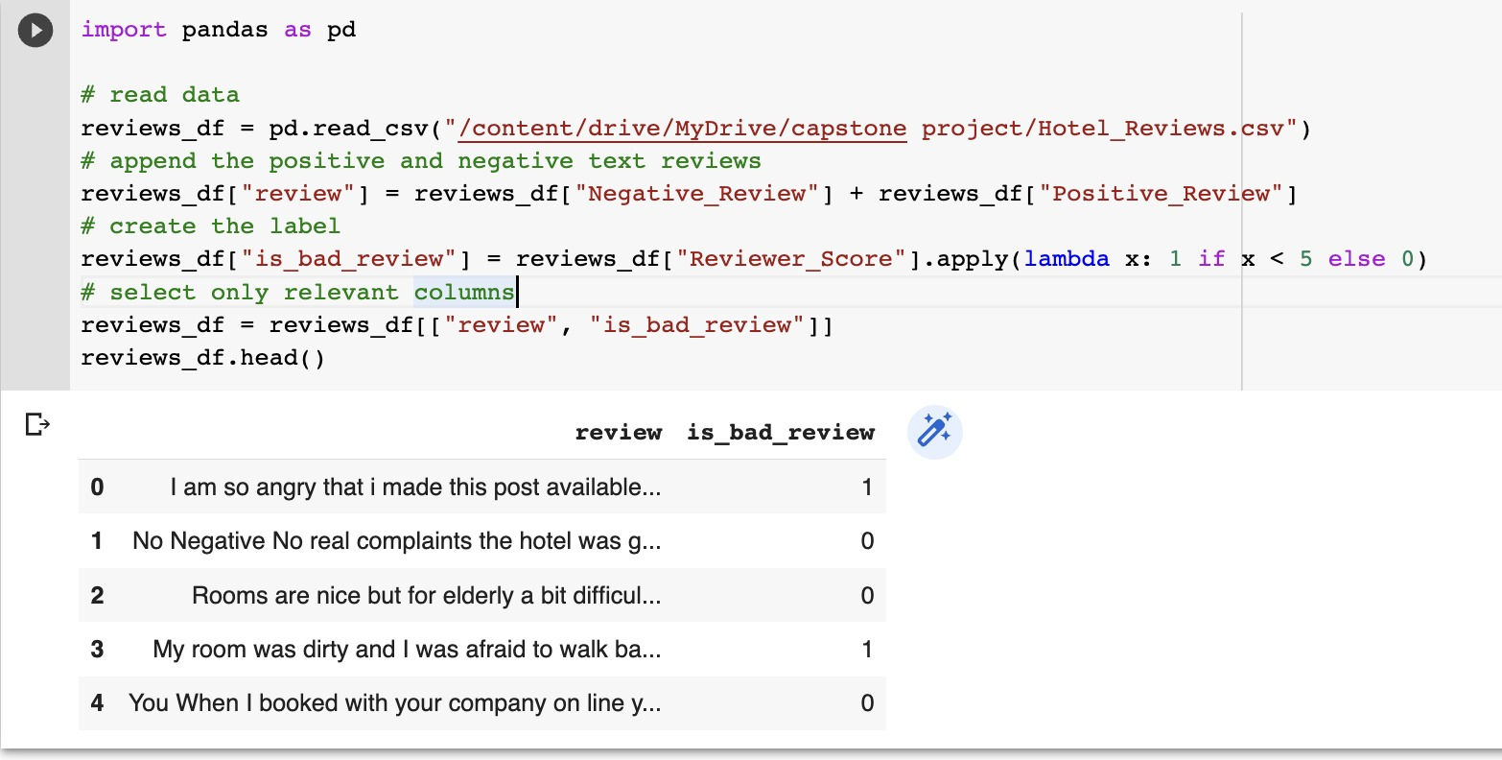
CONTD..
Using lambda function, we differentiated positive and negative reviews
Notes:
We first start by loading the raw data. Each textual reviews is splitted into a positive part and a negative part. We group them together in order to start with only raw text data and no other information.
Rating scale: 0-10
x<5 -> bad review
X>5 -> good review

Slide 28
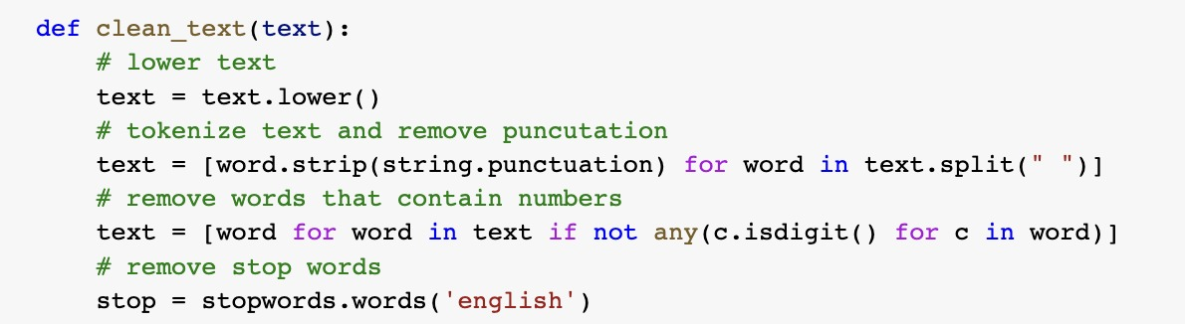
CONTD..
Convert the sentences to lower case letter as a step for preprocessing.
Remove special symbols like “”, !@#$ in our data.
Remove stop words and remove tokens like tags.
Notes:
Stop words are a set of commonly used words in any language. For example, in English, “the”, “is” and “and”, would easily qualify as stop words.

Slide 29
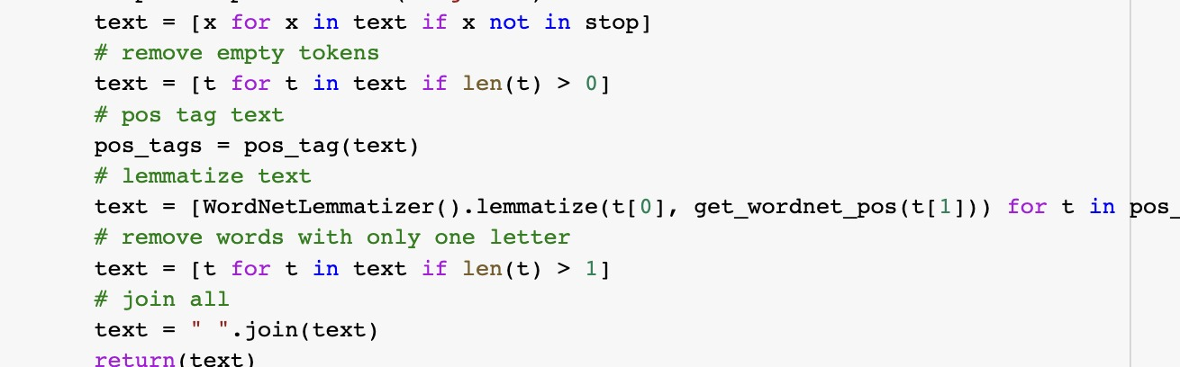
CONTD..
Assign a tag to every word to define if it corresponds to a noun, a verb etc. using the WordNet lexical database
Lemmatization is used to switch any kind of a word to its base root mode
Notes:
Part-Of-Speech (POS) tagging: assign a tag to every word to define if it corresponds to a noun, a verb etc. using the WordNet lexical database

Slide 30
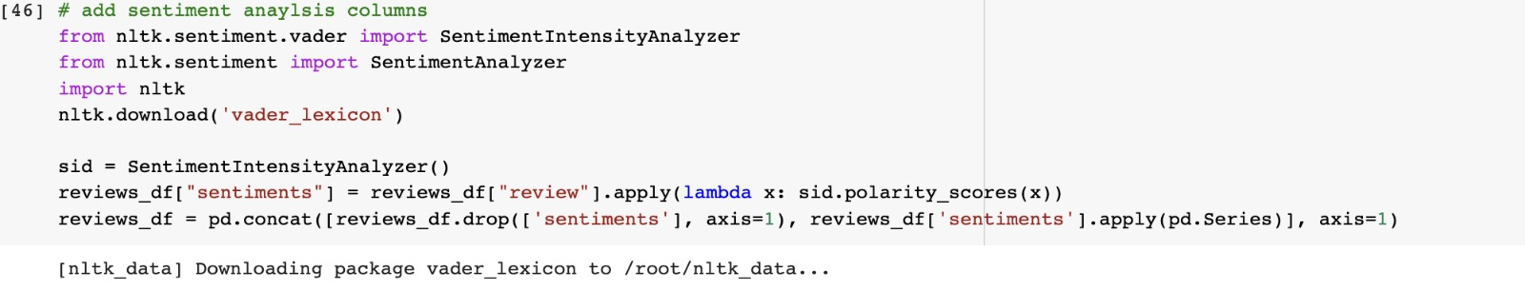
CONTD..
We use Vader, which is a part of the NLTK module designed for sentiment analysis. For each text, Vader returns 4 values:
a neutrality score
a positivity score
a negativity score
an overall score that summarizes the previous scores
We integrated those 4 values as features in our dataset
Notes:
Vader searches through his vocabulary to determine which words are positive or negative. To calculate the sentiment scores, it additionally considers the sentence context.

Slide 31
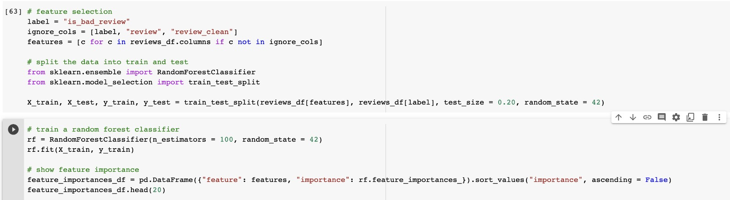
CLASSIFIER
Random forest is a flexible, easy to use machine learning algorithm that produces, even without hyper-parameter tuning, a great result most of the time.
Sklearn RandomForestClassifier can be used for determining feature importance.
The n_estimators parameter specifies the number of trees in the forest of the model.
Random state parameter is used to set the seed for the random number generator used to select features and samples when building each decision tree.
Notes:
Whenever used Scikit-learn algorithm (sklearn. model_selection. train_test_split), is recommended to used the parameter ( random_state=42) to produce the same results across a different run.
1. It is also one of the most used algorithms, because of its simplicity and diversity (it can be used for both classification and regression tasks.
2. It collects the feature importance values so that the same can be accessed via the feature_importances_ attribute after fitting the RandomForestClassifier model

Slide 32
CONTD..
Feature randomness generates a random subset of features, which ensures low correlation among decision trees. This is a key difference between decision trees and random forests.
To create feature names
df dataframe importances_df = pd. DataFrame({"feature_names" : rf. feature_names_in_, "importances" : rf.
Notes:
1. Each tree gets the full set of features, but at each node, only a random subset of features is considered.

Slide 33
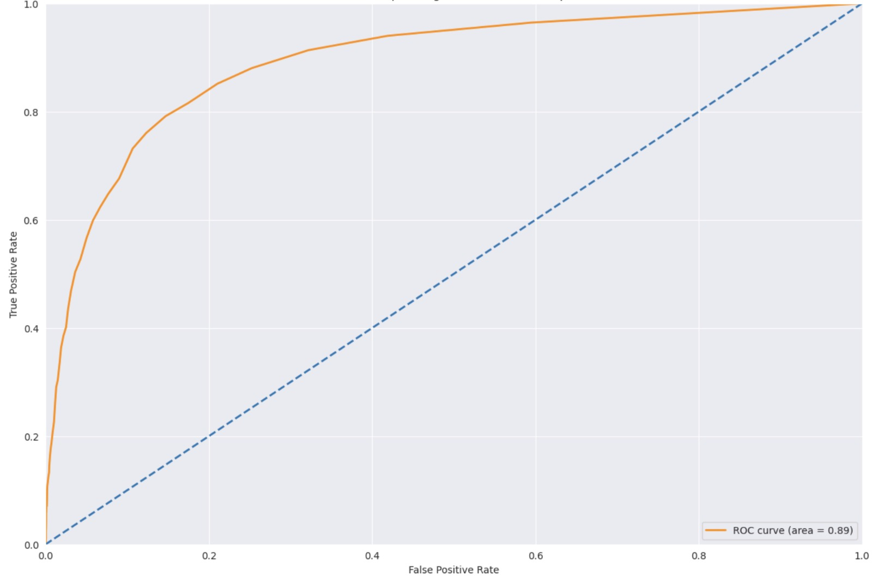
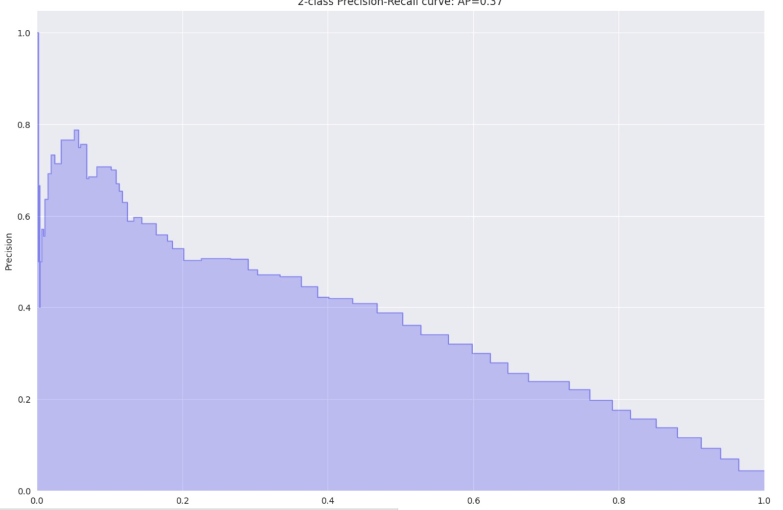
Performance & Evaluations
ROC CURVE
The ROC (Receiver Operating Characteristic) curve is usually a good graph to summarize the quality of our classifier
PR CURVE
To assess the quality of our model, we compare it to a simple decision baseline. Let's take a random classifier as a baseline here that would predict half of the time 1 and half of the time 0 for the label.
Notes:
The higher the curve is above the diagonal baseline, the better the predictions
ROC Curve value: 0.89
PR Curve , AP Score: 0.37

Slide 34
THANK YOU

